Slide 1
Capstone Project – The Battle of Neighborhoods
Selecting the most common neighbourhood in New York - Manhattan to open a new Luigi’s Pizza Joint.

Slide 2
Introduction
Background
Luigi is the CEO of Luigi's Pizza Joint, which started as a family owned and operated business in the 60's. Luigi already has a number of pizza restaurants in other cities in America, but he would like to expand their gourmet pizza business in New York, specifically Manhattan.
Business Problem
Luigi is concerned that there are already a number of pizza businesses in New York, specifically Manhattan, however none are to the same standard has Luigi's Pizza Joint. In this scenario, the aim is to identify a suitable location, on what basis is this choice suitable and identify the competition in that location.

Slide 3
Data Selection
Data Sources
I have chosen to use the New York data from the exercises (https://cocl.us/new_york_dataset). I will also be using my personal developer Foursquare to locate other Pizza restaurants.
How the data will be used
The main components of our analysis and predication system, this will comprise of four stages:
Collect Data
2. Explore and Understand Data
3. Data preparation and preprocessing
4. Modeling

Slide 4
Methodology
Collect New York Neighborhood dataset with latitude and longitude
Filter out Manhattan neighborhoods
Use Foursquare API’s to investigate venues in:
Manhattan
All neighborhoods in New York
Cluster the types of venues based on:
Commercial areas
Tourist areas and hubs

Slide 5
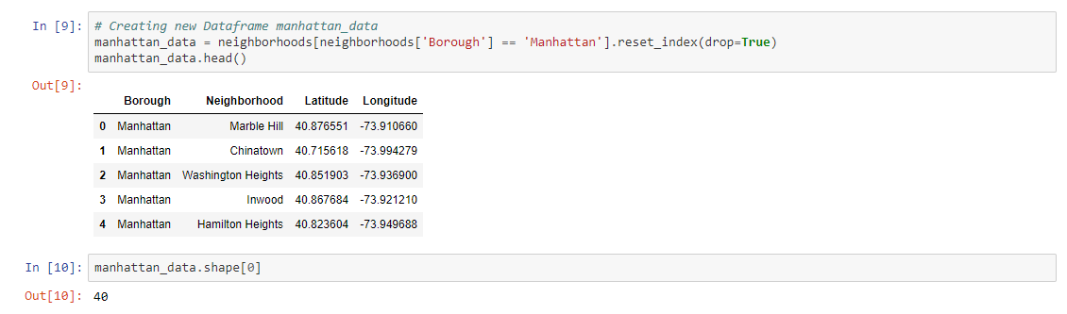
Methodology - Manhattan
Identify the number of neighborhoods in Manhattan (40)

Slide 6
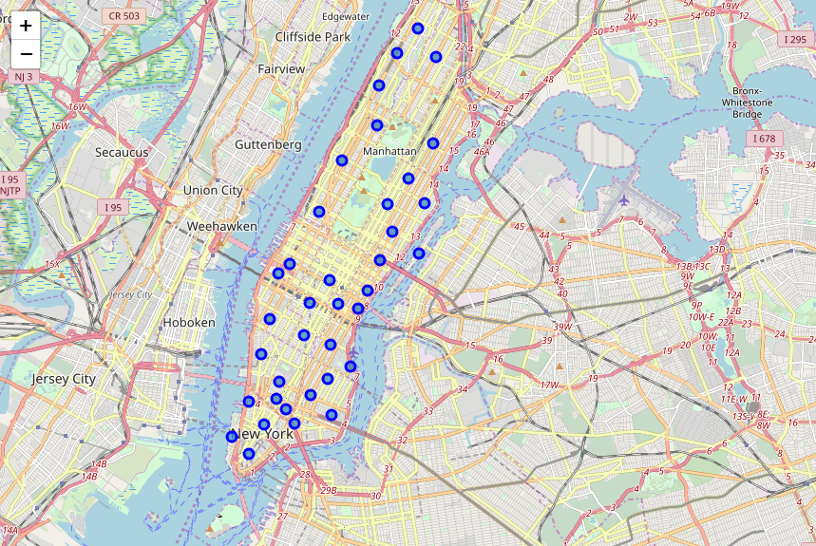
Methodology - Manhattan
Map the neighborhoods in Manhattan (40)

Slide 7
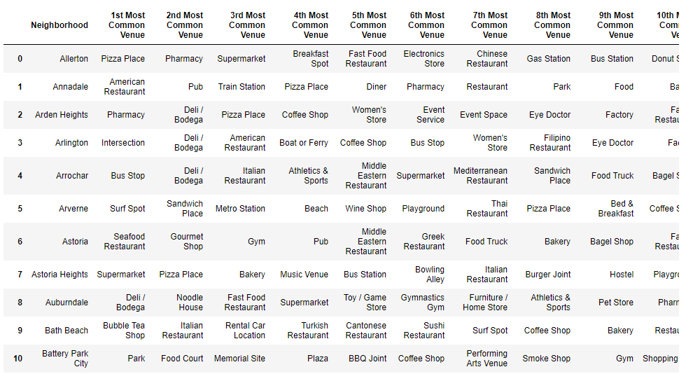
Methodology – All Neighborhoods
Analyse Foursquare venues across New York

Slide 8
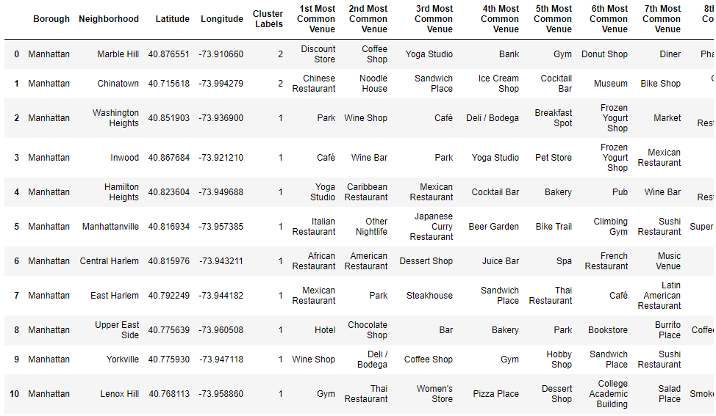
Results – Cluster Manhattan
Analyse Foursquare venues across Manhattan

Slide 9
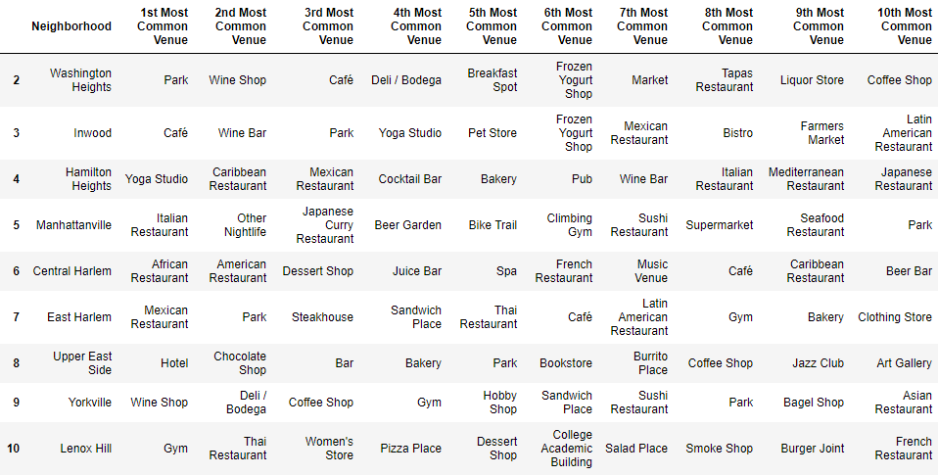
Results – Manhattan Commercial
Identify the number of commercial areas in Manhattan (37)

Slide 10
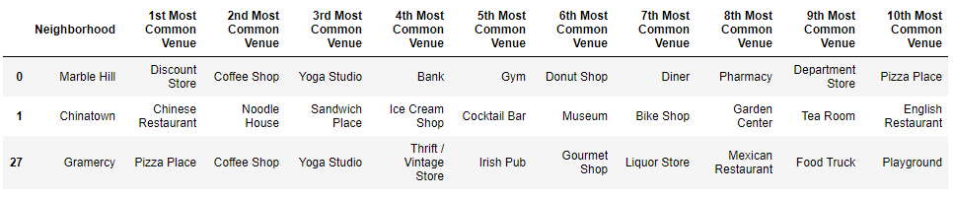
Results – Manhattan Tourist
Identify the number of tourist areas in Manhattan (3)

Slide 11
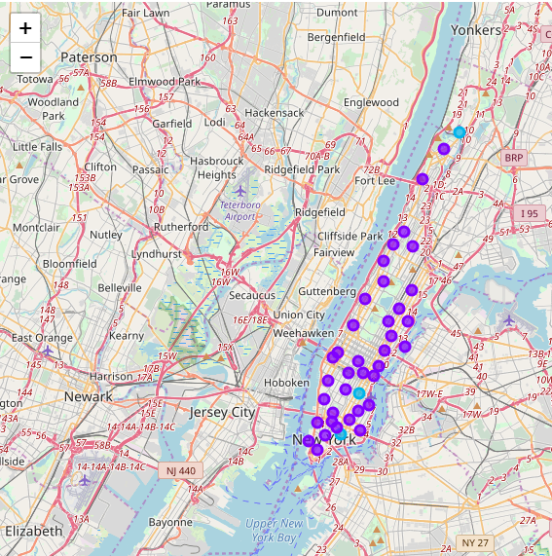
Results – Cluster Map Manhattan
Purple = Commercial
Blue = Tourist area

Slide 12
Results
From analysing the data, we have uncovered that Gramercy has the most common venue for pizza places in a tourist neighborhoods.
Lenox Hill and Clinton has the fourth most common venue for pizza places and Marble Hill is tenth in the commercial neighborhoods.
If Luigi would like to open his newest restaurant in Manhattan, Gramercy has the most amount of pizza places / venues at 15% of all venues. It would be stiff competition, however Luigi's pizza's are proven winners in other cities.

Slide 13
Discussion
This analysis was performed on a limited neighborhood as Luigi wanted to set up his establishment in Manhattan.
Looking at the other neighborhoods in New York, it is obvious that pizza venues are in general very popular, it would be worthwhile investigating those neighborhoods closely and investigating further.

Slide 14
Conclusion
When analysing the data from other neighborhoods in New York, pizza places are generally quite popular in general.
33 out of the 301 neighborhoods in New York had a 1st Most Common Venue, so pizza places are definitely popular, however it will be competitive.
I would probably recommend that deeper analysis should be made whether Manhattan is actually the best area for Luigi’s new pizza joint based on the high number of existing pizza venues.

